Slide 1
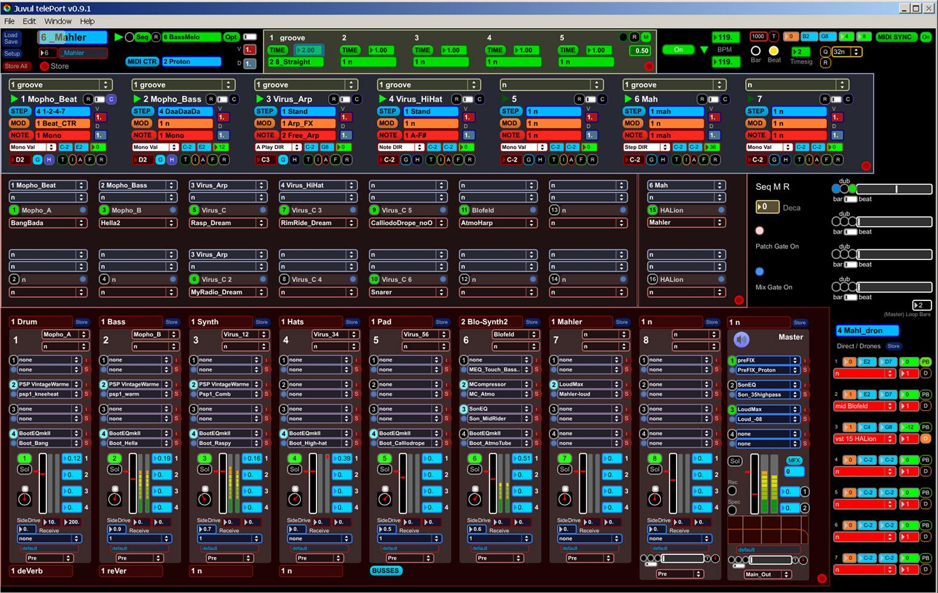
Designing algorithmic music composition and playback
Matt Bellingham
matthew.bellingham@open.ac.uk
Supervised by Simon Holland and Paul Mulholland
Notes:
Have my probation viva on Monday

Slide 2
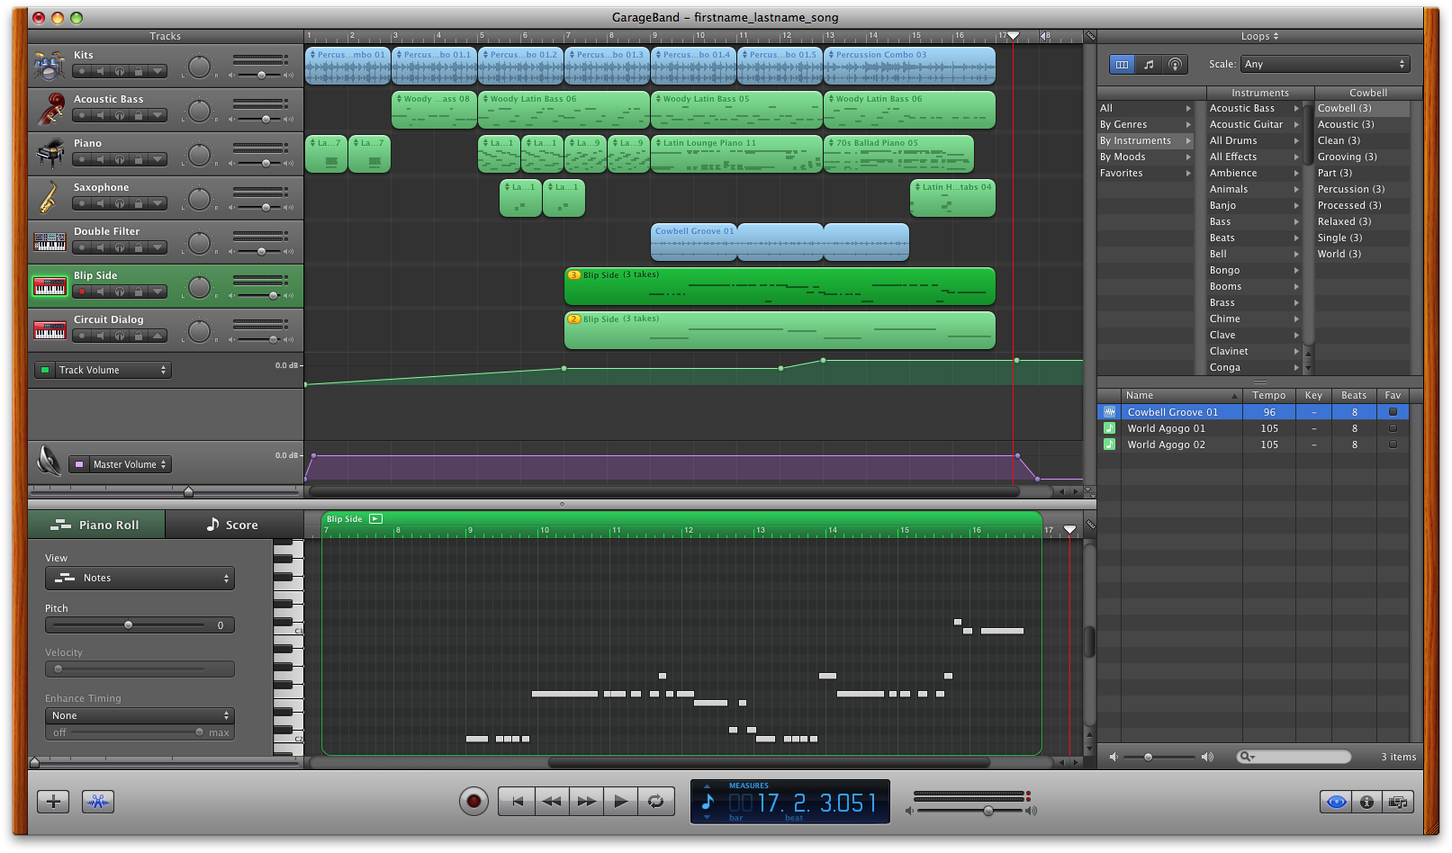
How can expressive algorithmic composition software be made more productive and engaging for novice users?
Notes:
What is it?
The use of formal procedures to make music without human intervention
In this instance, music which is different every time it is played - links to generative music.
Use limited to those with programming knowledge
Development of an engaging musician-facing interface - an ‘algorithmic GarageBand’

Slide 3
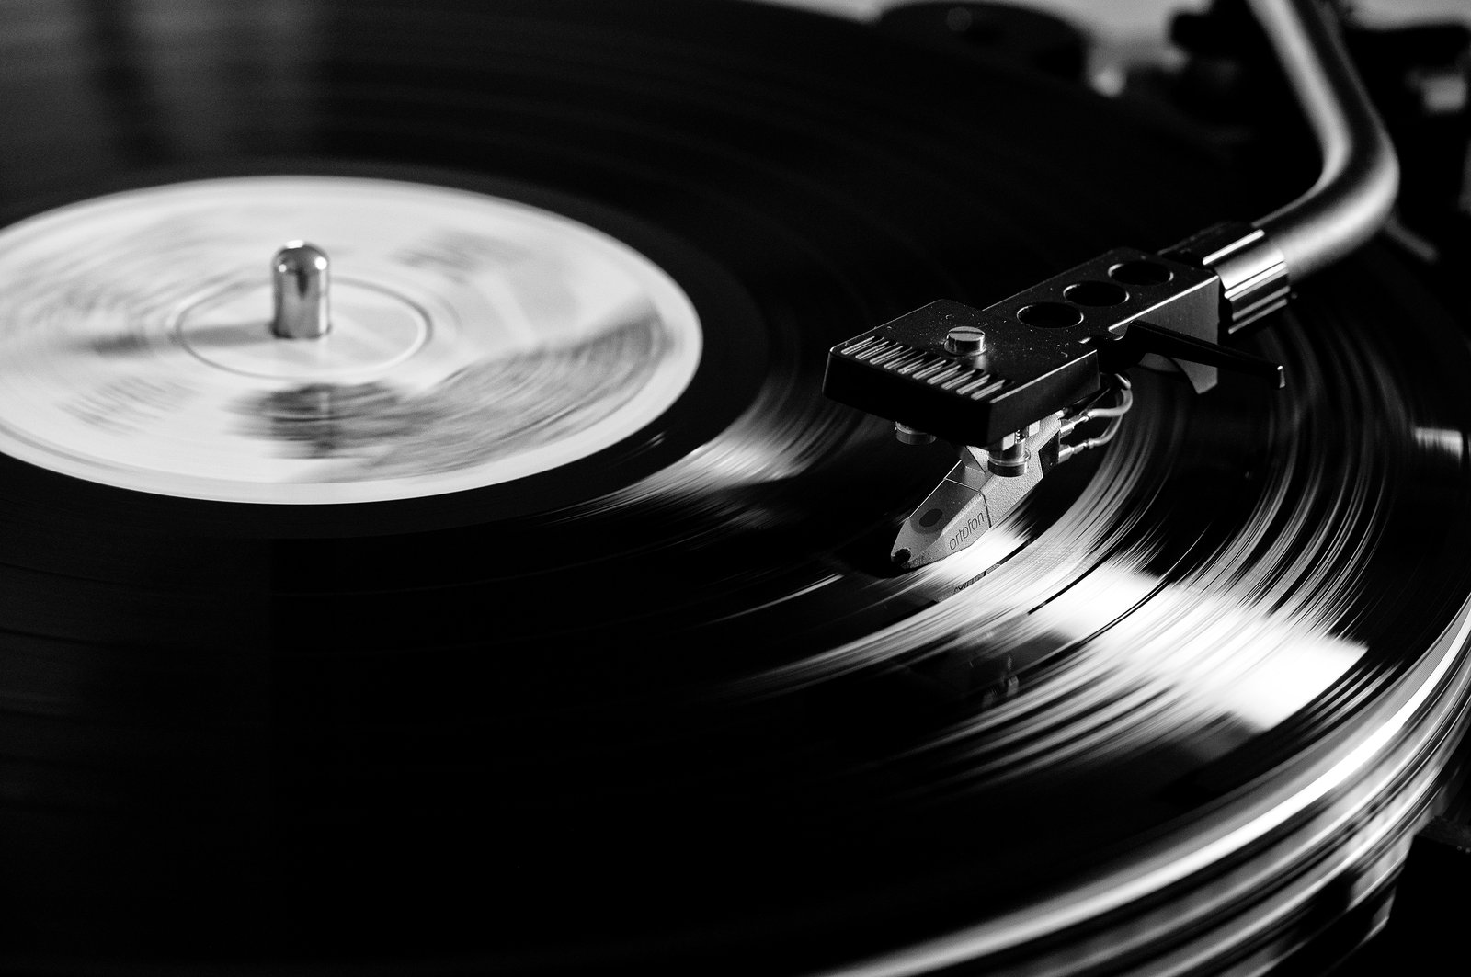
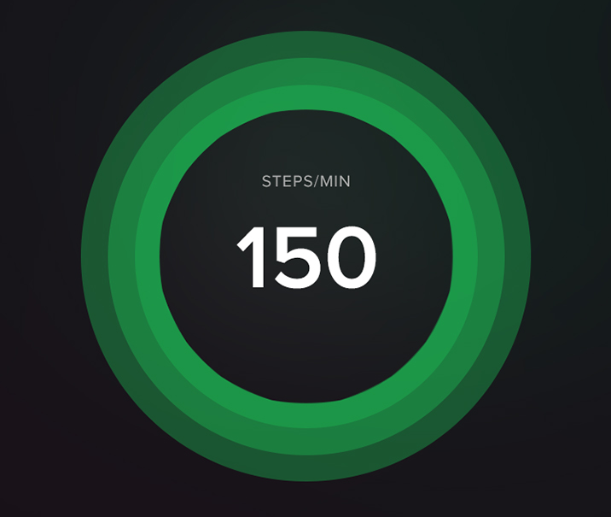
How can expressive algorithmic composition software be made more productive and engaging for novice users?
Notes:
Links to the authenticity of recorded performance - upcoming
Contribute to a shift within domestic non-linear playback - the shift away from physical media is leading to some interesting developments, such as the Spotify running mode which takes the BPM from phone accelerometer. ‘Running Originals’ is interesting element.

Slide 4


Background
Aleatory, chance and indeterminacy
Stochastic and AI approaches
Authenticity and phonography
Performance and reification
Notes:
By way of background…
Alea = dice
Indeterminacy can be introduced at the compositional stage, or by allowing performer choice, or both. Cage’s use of chance.
Stochastic = random variable, first coined in music by Iannis Xenakis. More mathematical in form. Markov chains in Analogiques
AI. Example - David Cope system which composes classical music = Experiments in Musical Intelligence
Long history of chance in music
Dice games - i.e. Mozart
Aleatoric/indeterminate elements in composition or performance
Stochastic systems and AI
Links to non-linear playback in game sound
Is music a process or a product? Composers can be unhappy with musicians, or with recordings
Relationship between author and reader - unmediated transmission
Recording as an idealised representation of the music
Is the record separate from the live performance?
Performer as intermediary - instructions and ‘retrieval’
Phonography - photography - ‘fixity is death’
Music became reified - fixed and repeatable
The recording as idealised end-point
Phonography: new art vs. live performance

Slide 5
Findings to date
Cognitive Dimensions of Notations analysis of existing software:
Requires significant user knowledge
Use of metaphor
Imposes a defined working practice
Lack of structural awareness
Complex visual design
Notes:
CDN analysis presented at the PPIG Psychology of Programming Interest Group conference, 2014
Led to methodology and then design. CDN will also lead to critiquing.
Requires significant user knowledge
Much of the reviewed software requires the user to be competent in the design and implementation of algorithms within either text-oriented or graphical programming environments. A selection of software assumes musical knowledge, and some software requires the user to understand both areas.
Use of metaphor frequently requires prior knowledge in another domain
The use of metaphor is broadly applied in the area. Graphical programming languages make use of a patch-cable metaphor, while other software reference mixing desks, musical staff notation or sequencer-like piano rolls. Metaphor can be used to infer purpose and to leverage existing knowledge but it can also present a barrier to users with limited experience in the referenced fields.
Imposes a working practice which is not conducive to some compositional processes
Some reviewed software requires users to commit to a particular design which is subsequently difficult to change once the patch has become more complex.
A lack of structural awareness
The user is not easily able to define, and subsequently change, the musical structure to be used in the composition. Users are able to create patches which express structure when using one of the reviewed programming languages but this requires significant programming knowledge.
Complex visual design leading to low visibility and juxtaposability
The reviewed software exhibits a wide range of graphical design. Graphical programming languages, using a patch- ing metaphor, allow complex operations but visibility is significantly reduced once the patch’s size increases. There are also issues with surfacing pertinent information and allowing the user to easily compare several elements.

Slide 6
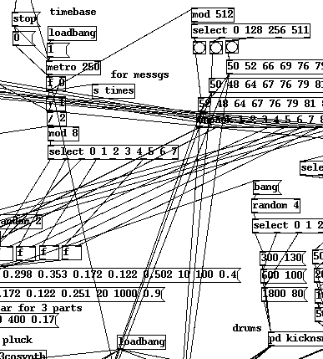
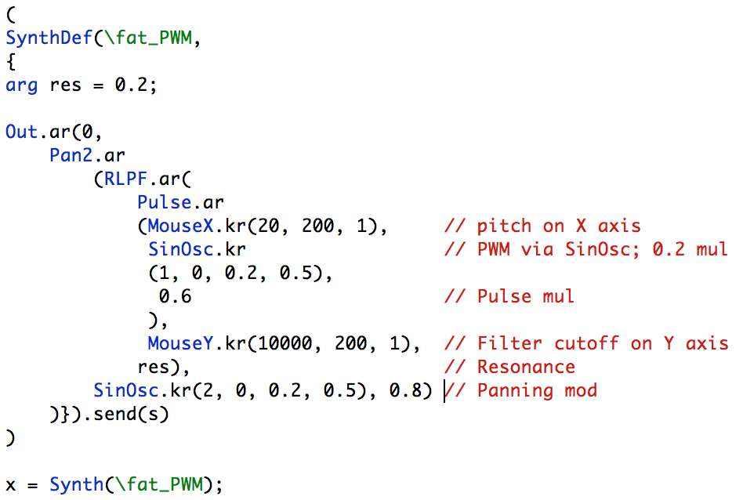
Notes:
Graphical and text-oriented languages
The two most widely used?

Slide 7
Candidate framework
Minimise the learning required
Allow for flexible working practice
Be structurally aware and visually simple
Candidate interaction framework: Direct Combination, a development and generalisation of Slappability
Notes:
Requirements for the framework. DC is one possible route.
DC allows users to select any number of interaction objects and uses this selection to constrain the search space of possible commands. In this way users can indicate which objects they wish to use without having to learn or remember the operations that the system allows. The selection of objects narrows options to those that are contextually relevant.
DC is a suitable candidate for the proposed research activity due to its ability to accept input commands in many different orders, offering a good match for the spontaneous methodology often used in music composition.
Users will not have to learn a potentially large number of operations in order to use the software; such operations can be abstract and therefore difficult to recall. The user will be able to select the objects they wish to manipulate and the system will constrain options to show only contextually relevant content.

Slide 8
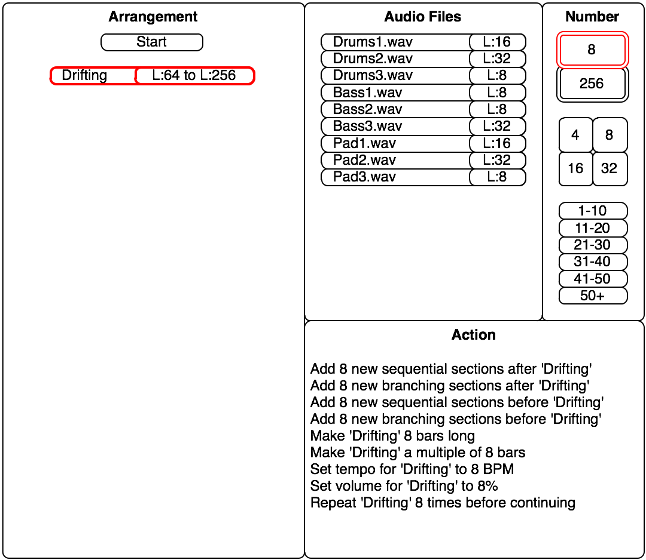
Notes:
Example; an arrangement object is selected, and the possible actions are constrained by the choice of a number. Further selections would impose further constraints.

Slide 9
Research through design
Iterative creation and evaluation of composition systems
Early iterations to use software usability inspection methods to develop hypotheses to inform subsequent iterations
Final stage prototypes to be evaluated through observation of end users
Notes:
Hypothesis is that people would be engaged if the way it worked could be improved. Nobody will know until we have a go. Tests give us some data to tune the development. We need to create the thing to study it. Ask questions about the iterations, gather data etc. Have to propose something - cold start.
Look at what works well and make some abstract hypotheses. These will make predictions on what other interfaces may or may not do better. Candidate predictions which will be tested. Hypothesis is a system to test. Each decision is a hypothesis. Embodies explicit and implicit assumptions which may go wrong.
Rittel - Social problems cannot easily be described and are referred to as 'wicked' problems rather than 'tame' problems as can be found in science. No definitive and objective answers for the social good etc.
Gaver - Theory may be best seen as 'annotation of realised design examples'
Not convergence but ‘take pride in its aptitude for exploring and speculating, particularising and diversifying, and - especially - its ability to manifest the results in the form of new, conceptually rich artefacts'
Research through design is likely to produce theories that are provisional, contingent, and aspirational'. Variation is not a problem but actually a natural state for 'generative endeavour'.

Slide 10
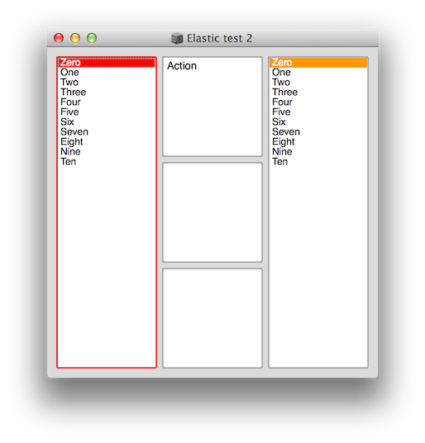
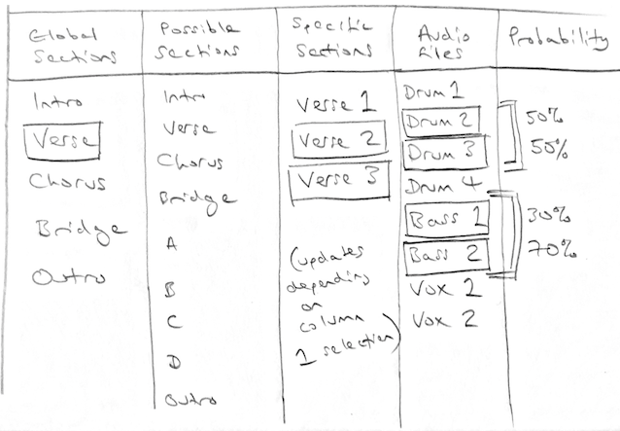
Notes:
Examples of pilot work. Early column-based design sketch showing possible interaction between depots.
Later SuperCollider-based design showing basic interaction between elements.

Slide 11
Future work
Pilot software testing
Research leading to personas
Early development of alternative software prototypes
Development of the final stage prototype
Empirical summative end-user studies

